Slide 1

Topic : Telecommunication Churn
Team members:
Mayank Singh
Pranavi Ch
Shantanu Kadam
H Sameer Bhairapur
Group no : 4

Slide 2
Architecture:
Kick off Business Objective and Discussion
Data set Details / EDA
Feature Engineering
Model Building
Model Evaluation
Feedback
Deployment
Final Presentation

Slide 3
Business Objective :
Customer churn is a big problem for telecommunications companies. Indeed, their annual churn rates are usually higher than 10%. For that reason, they develop strategies to keep as many clients as possible. This is a classification project since the variable to be predicted is binary (churn or loyal customer). The goal here is to model churn probability, conditioned on the customer features.

Slide 4
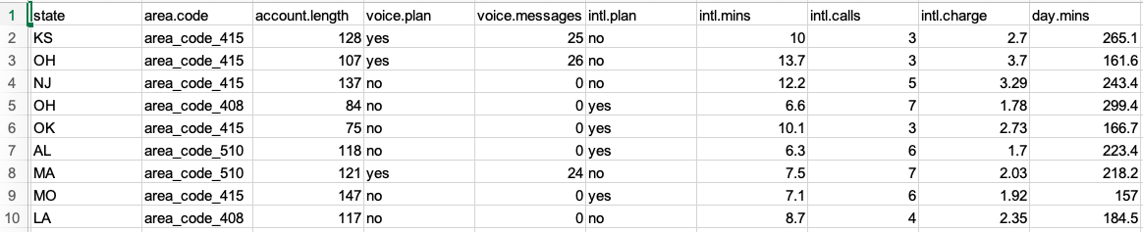
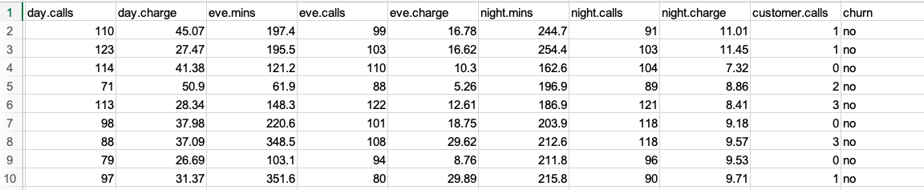
Data Set

Slide 5
Variable Description:
state: Categorical, for the 51 states and the District of Columbia.
Area.code
account.length: how long the account has been active.
voice.plan: yes or no, voicemail plan.
voice. Messages: number of voicemail messages.
intl.plan: yes or no, international plan.
intl.mins: minutes customer used service to make international calls.
intl.calls: total number of international calls.
intl.charge: total international charge.
day.mins: minutes customer used service during the day.
day. calls: total number of calls during the day.
day.charge: total charge during the day.

Slide 6
eve.mins: minutes customer used service during the evening.
eve.calls: total number of calls during the evening.
eve.charge: total charge during the evening.
night.mins: minutes customer used service during the night.
night.calls: total number of calls during the night.
night.charge: total charge during the night.
customer.calls: number of calls to customer service.
churn: Categorical, yes or no. Indicator of whether the customer has left the company (yes or no).

Slide 7
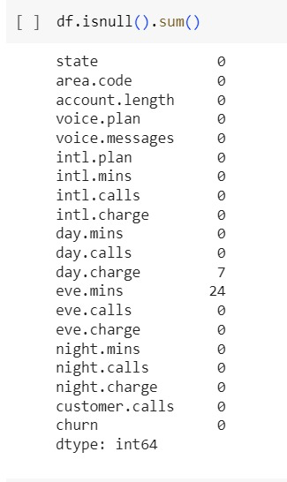
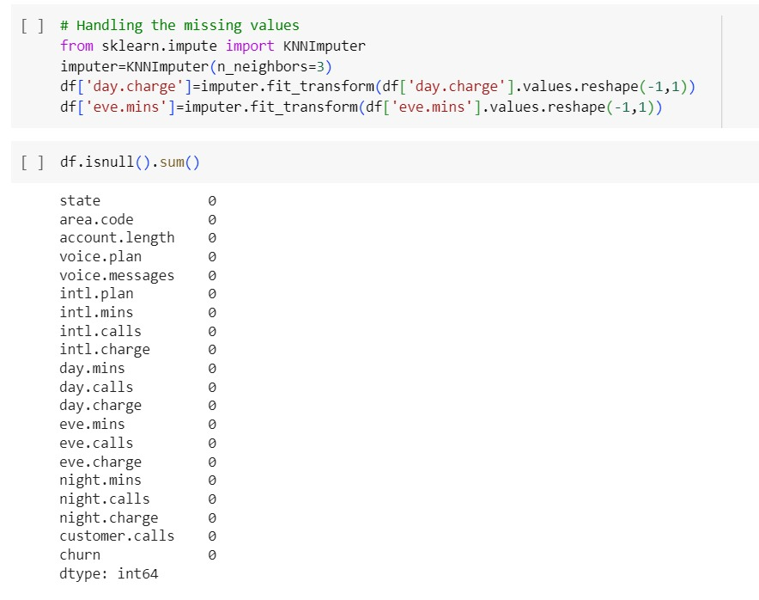
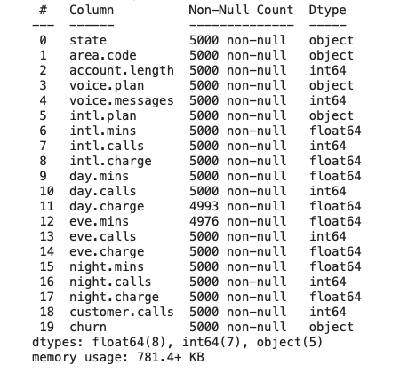
EDA and Data Visualization
Check for missing Values
We used KNN inputter
Information of the columns by df.info

Slide 8
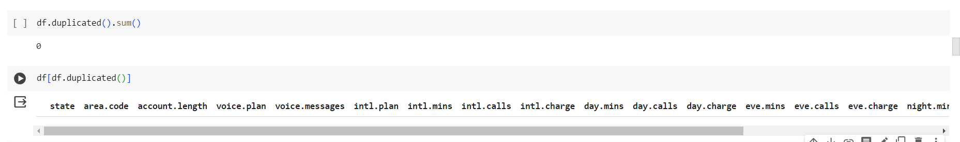
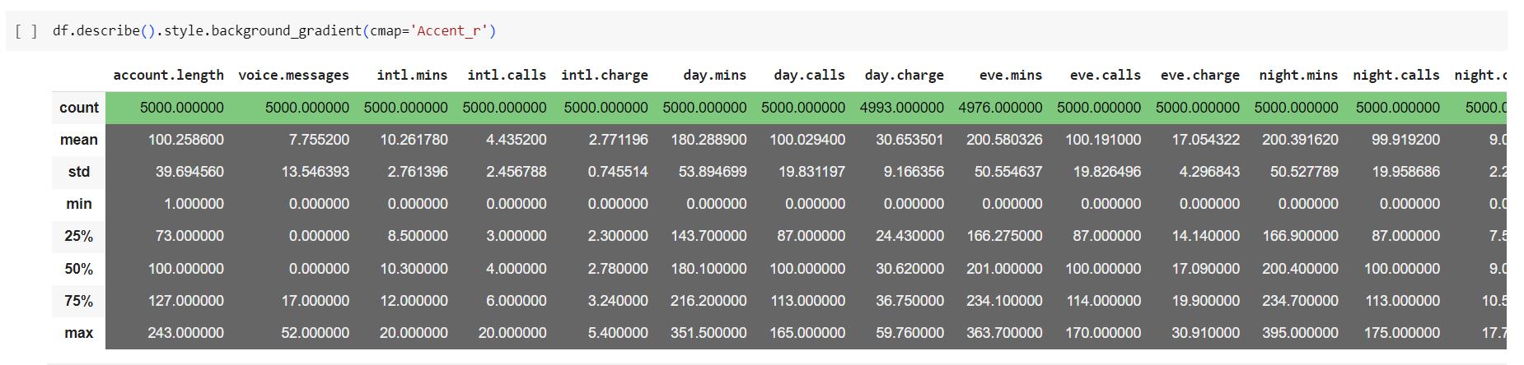
Duplicate Values Checking
Descriptive analysis using df.describe

Slide 9
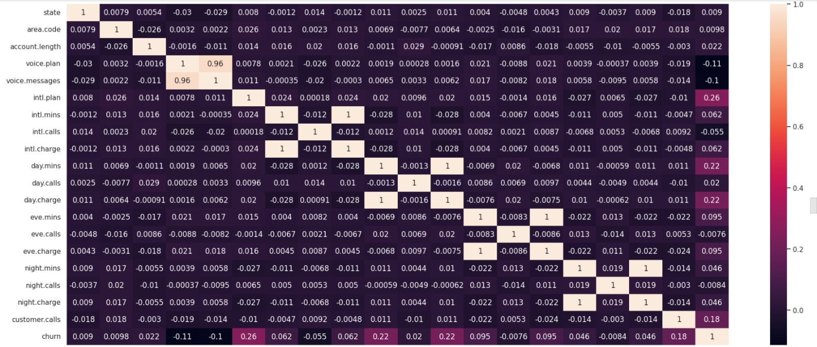
EDA Visualization
Correlation between the independent variables

Slide 10
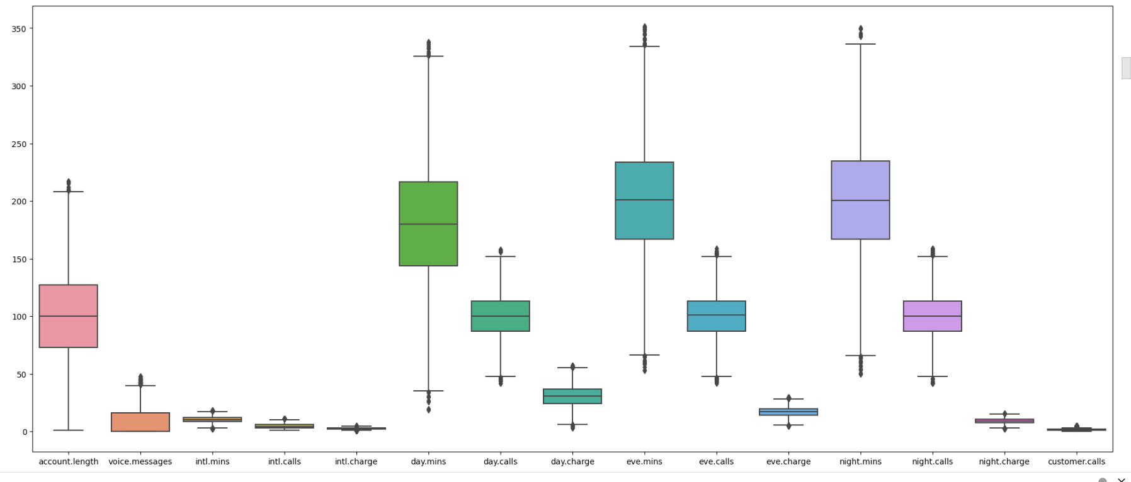
Outliers Detection
After detecting the outliers we have removed them and now our dataframe shape is
(4741,20).

Slide 11
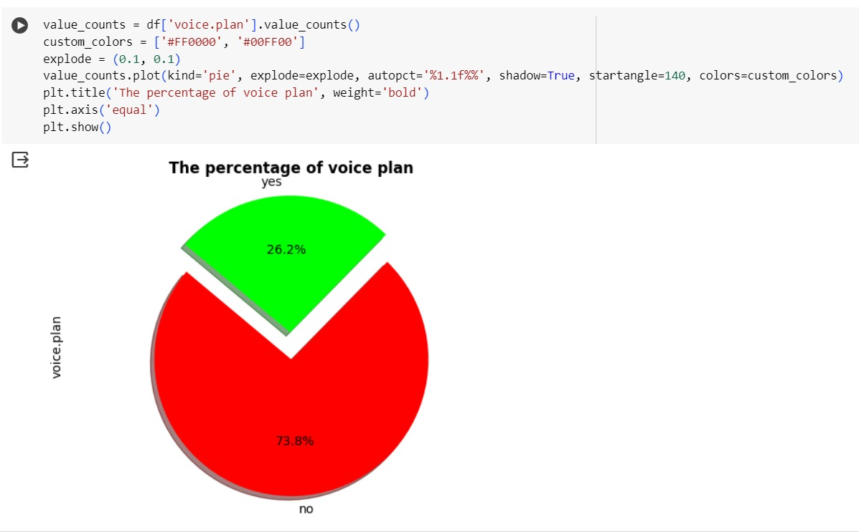
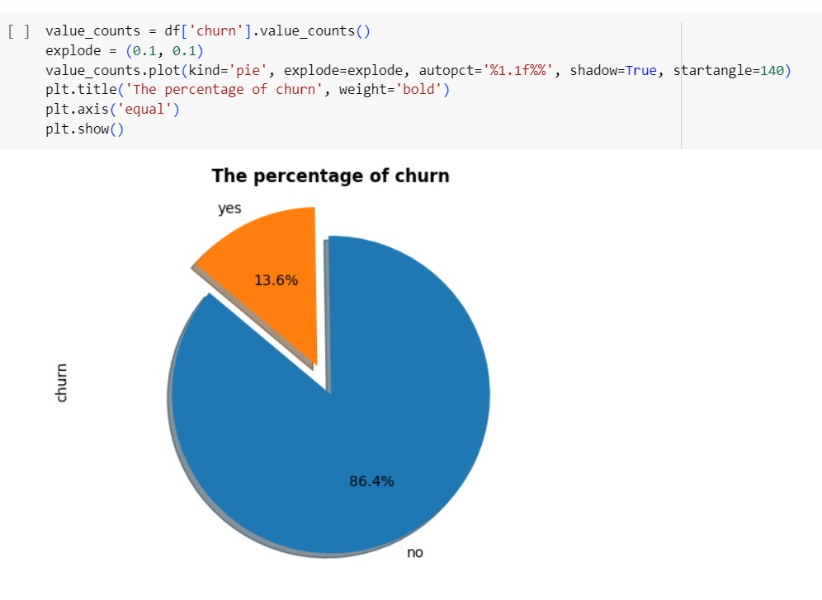
Percentage of churn
Churn is 13.6%
Non churn is 86.4%

Slide 12
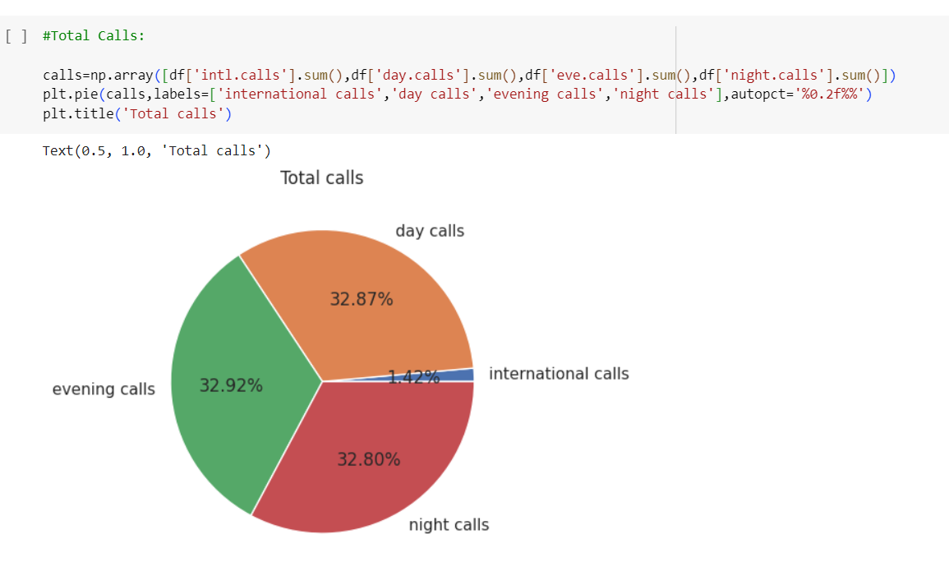
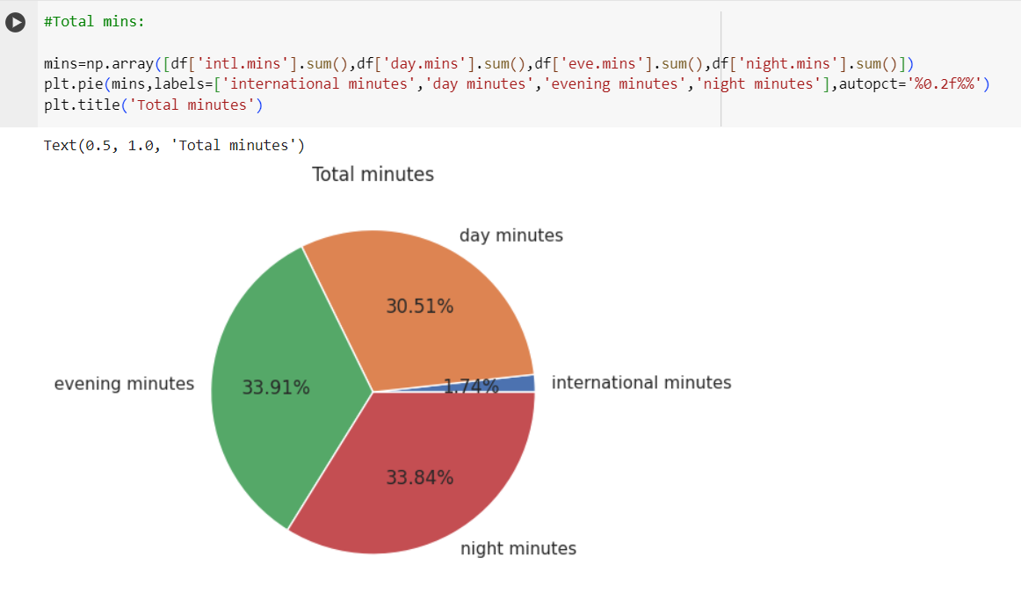
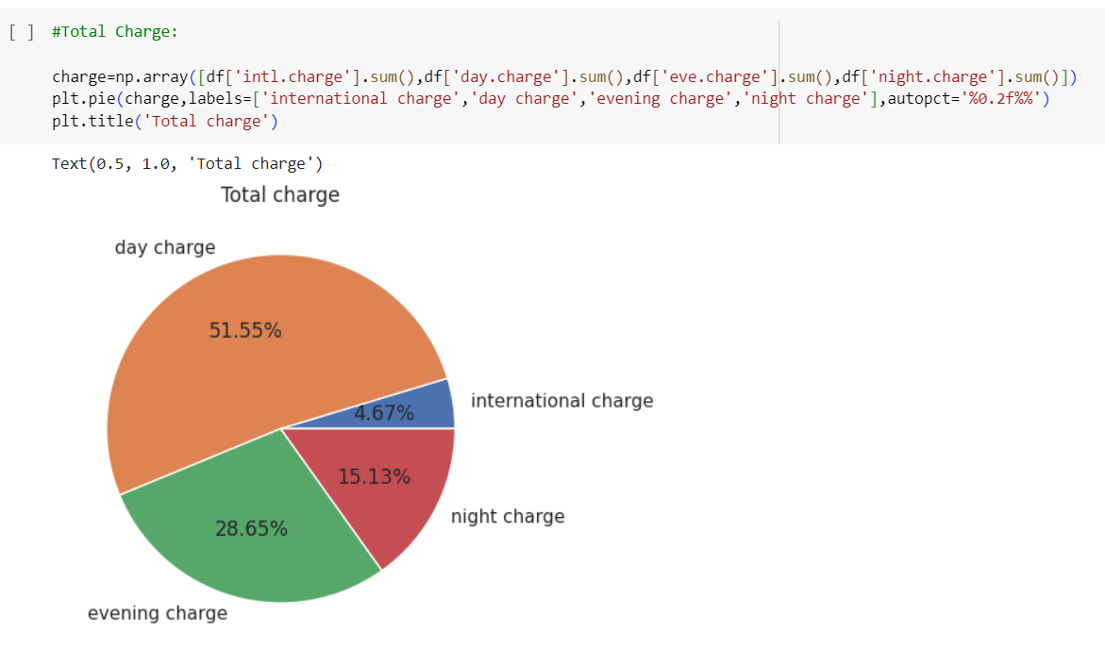

Slide 13
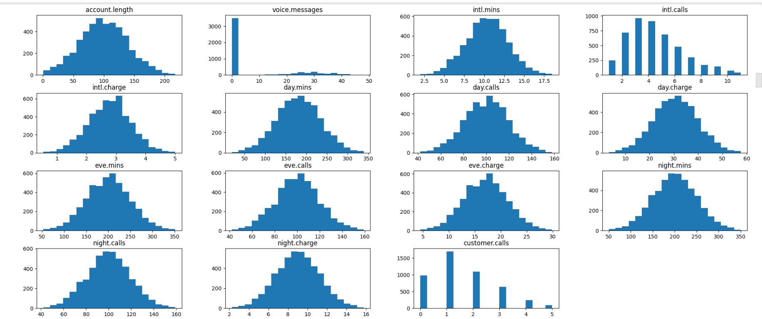
Histograms of all Numerical Columns:

Slide 14
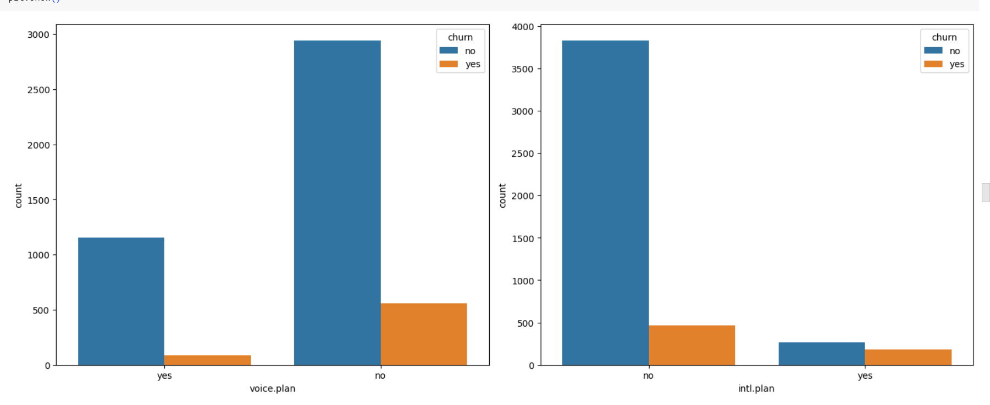

Slide 15
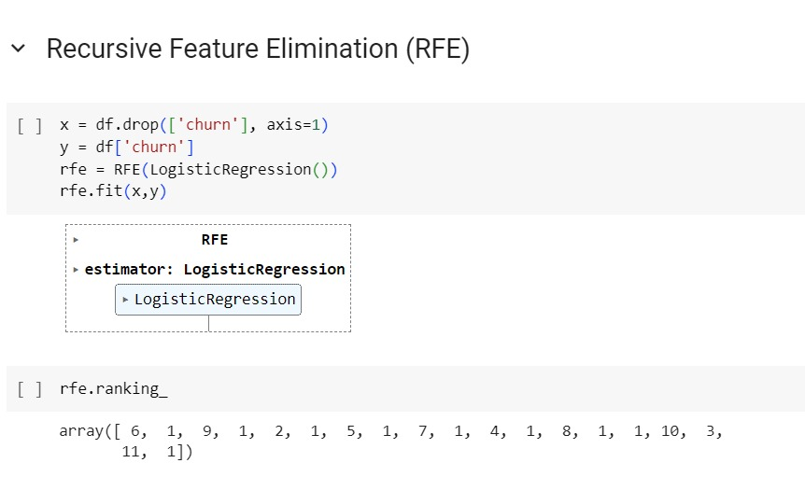
Feature Selection
Recursive Feature Elimination
For Feature Selection we have used :
Recursive feature elimination using logistic regression
Random forest classifier
SelectKBest

Slide 16
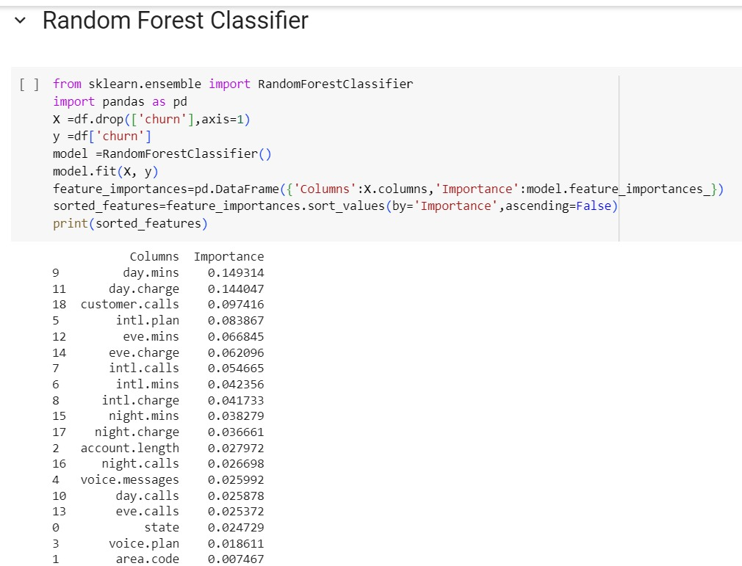
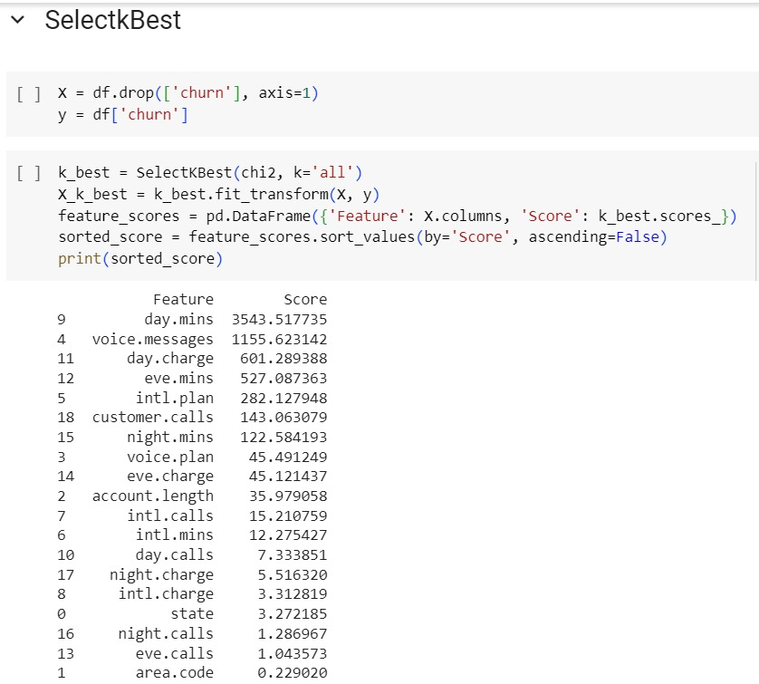
Random Forest Classifier
Select Kbest

Slide 17
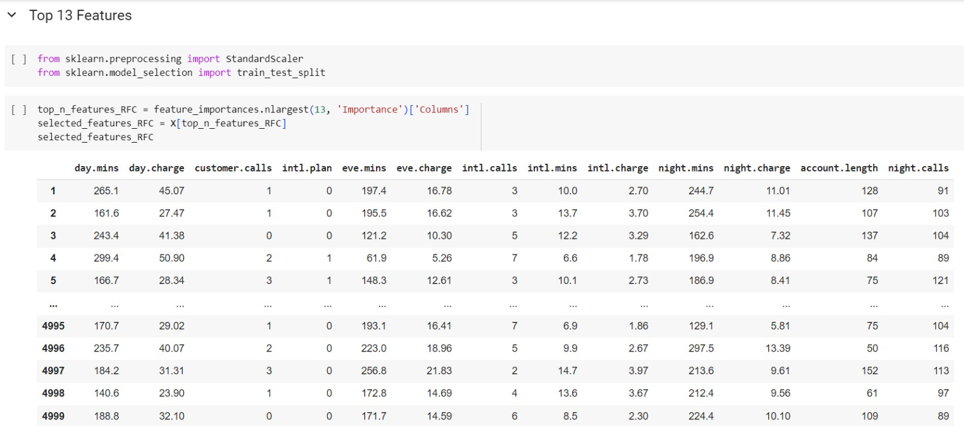
Scaling Down the data to keep the values in same range

Slide 18
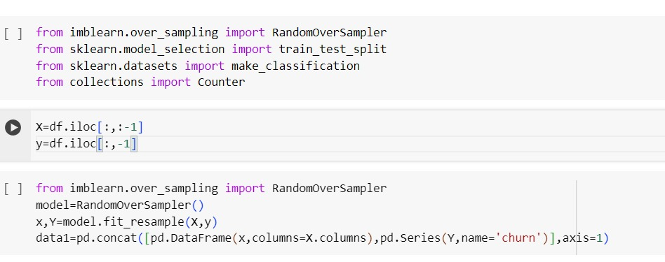
Balancing the Data Set

Slide 19
MODEL BUILDING:
Models Used for Model Building
Decision Tree Classifier
Random Forest Classifier
K Neighbors Classifier
Gradient Boosting Classifier
XGB Classifier
LGMB Classifier
Gaussian NB
Multinomial NB
Bernoulli NB
Ada Boost Classifier
Cat Boost Classifier

Slide 20
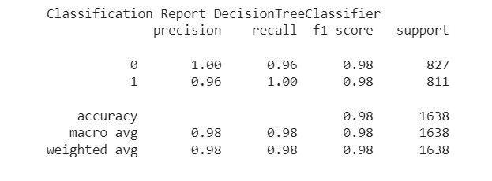
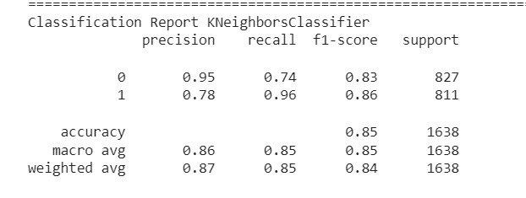
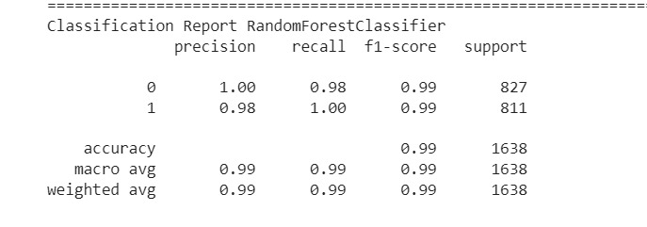
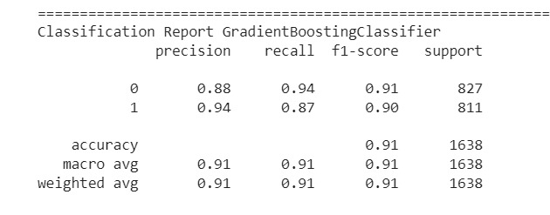
Decision Tree Classifier
K Neighbors Classifier
Random Forest Classifier
Gradient Boosting Classifier

Slide 21
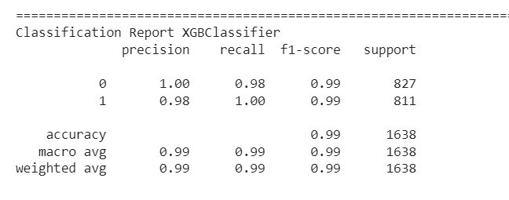
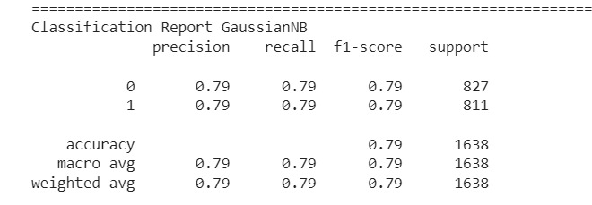
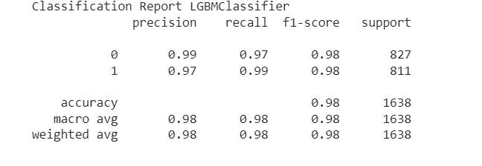
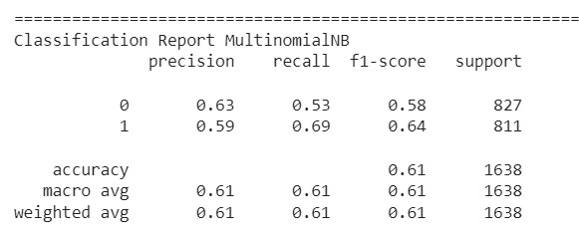
XGB Classifier
Gaussian NB
Multinomial NB
LGMB Classifier

Slide 22
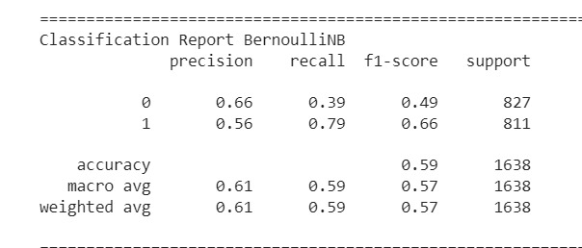
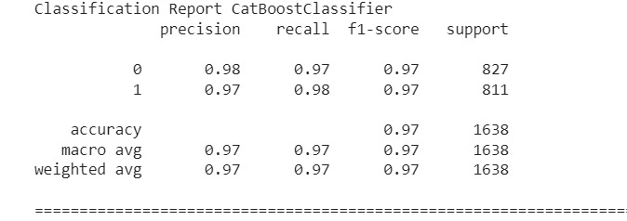
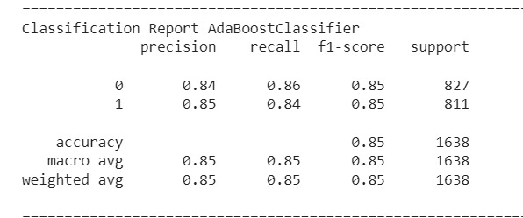
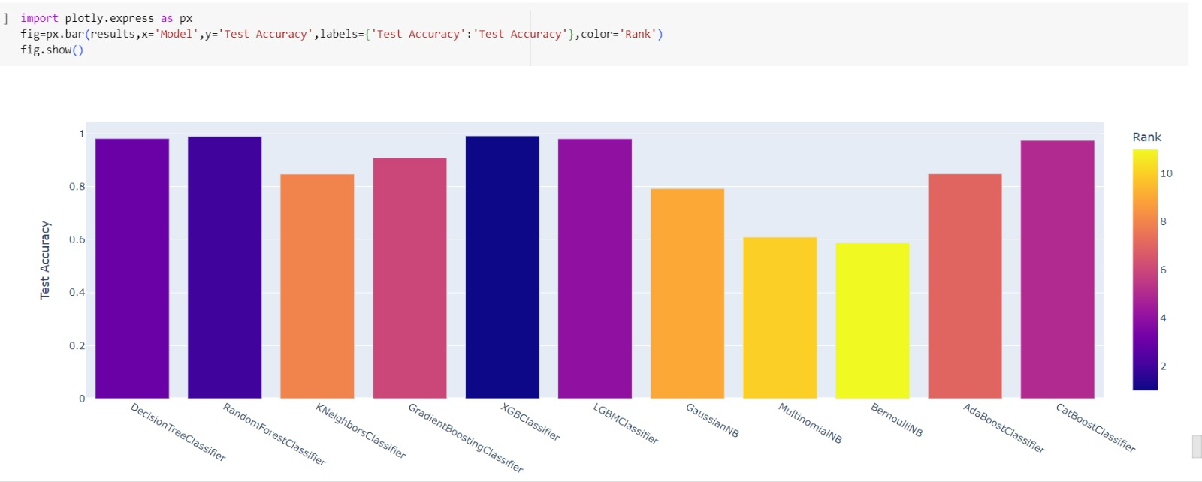
Bernoulli NB
Cat Boost Classifier
Ada Boost Classifier

Slide 23
S.No | Model Name | Train Accuracy | Test Accuracy
1 | Decision Tree | 1.000000 | 0.981074
2 | Random Forest | 1.000000 | 0.989621
3 | K Nearest Neighbours | 0.900458 | 0.846764
4 | Gradient Boosting | 0.903511 | 0.908425
5 | XGB Classifier | 0.999695 | 0.990842
6 | LGBM Classifier | 0.995420 | 0.980464
7 | Guassian NB | 0.784275 | 0.791819
8 | Multinomial NB | 0.612214 | 0.609280
9 | Bernoulli NB | 0.603969 | 0.588523
10 | Cat Boost Classifier | 0.839542 | 0.847985
11 | Ada Boost Classifier | 0.988244 | 0.973748
After seeing all the training and testing Accuracy we selected Random Forest Algorithm for further Analysis.

Slide 24
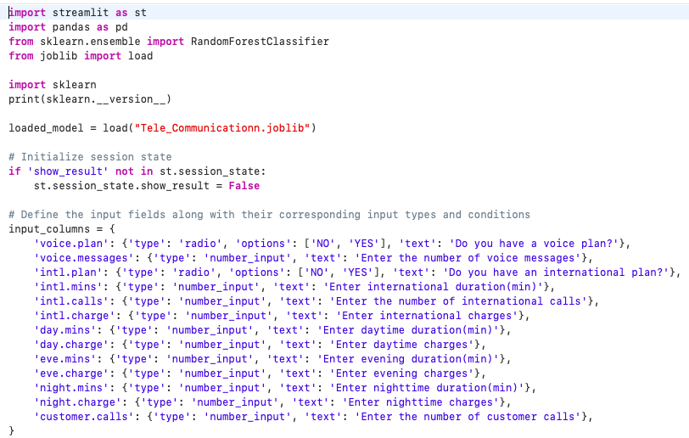
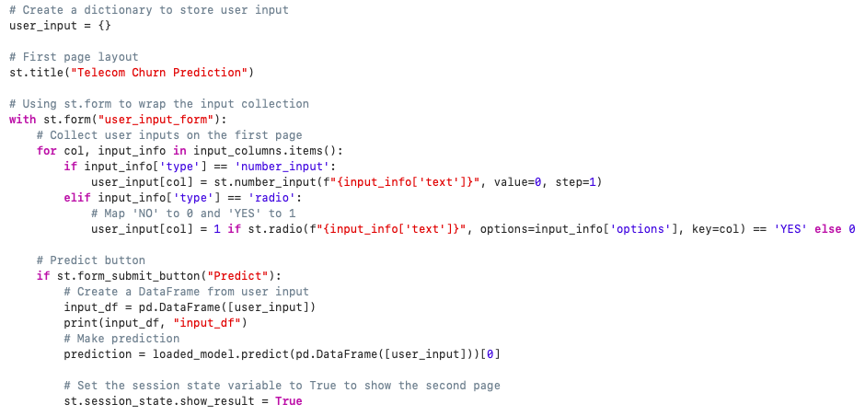
Deployment
After the Model building and Evaluation process, we have deployed the code using “Streamlit”

Slide 25
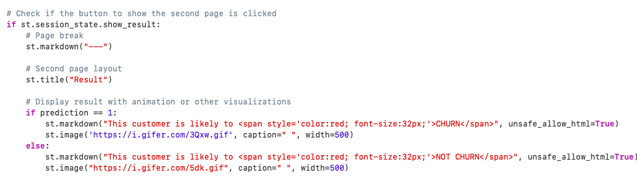

Slide 26
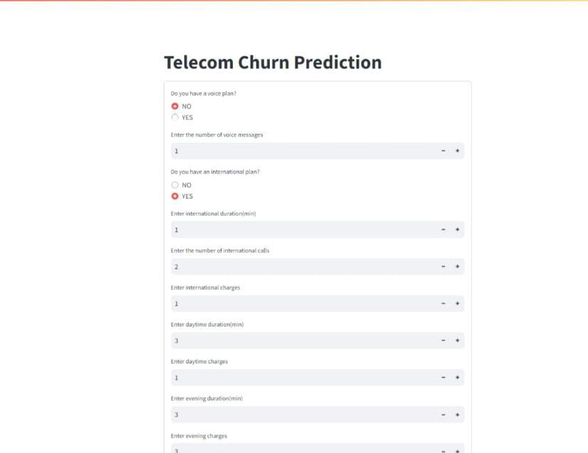
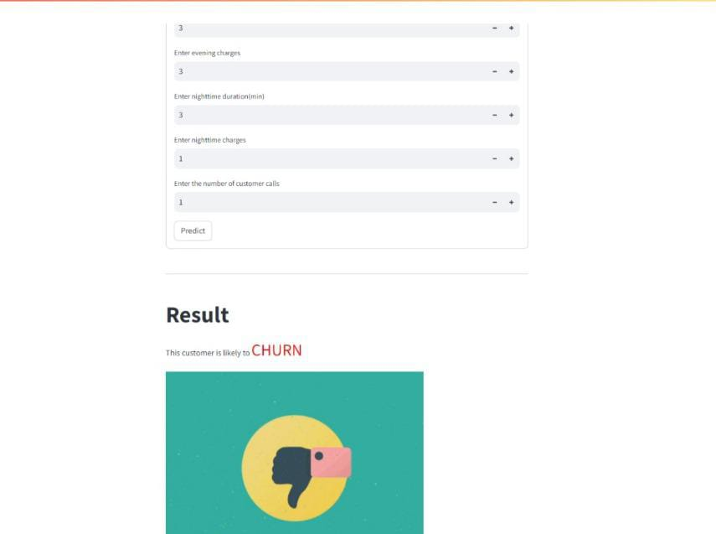
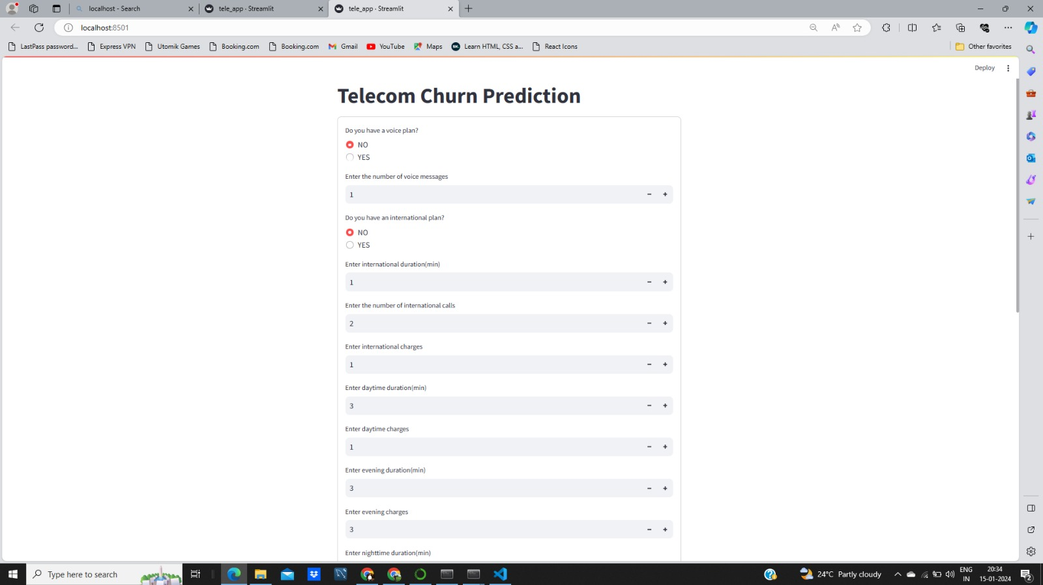
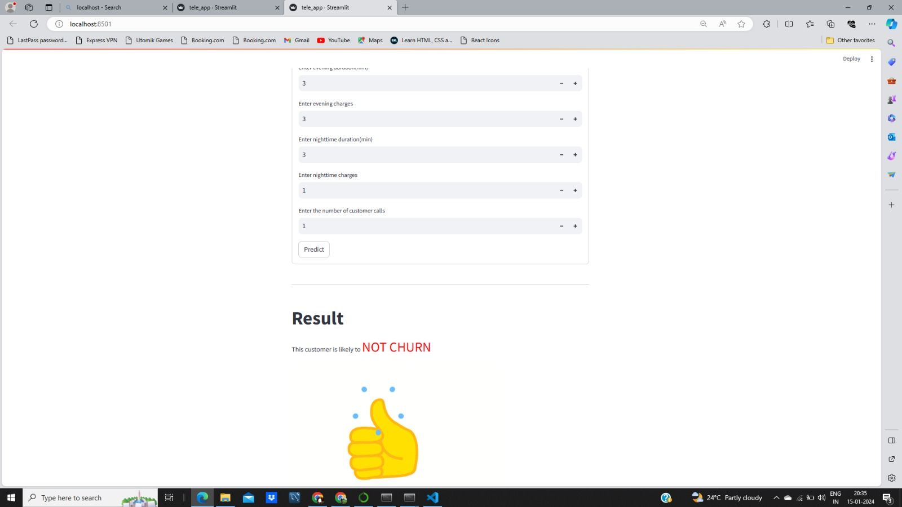

Slide 27
THANK YOU

